Slide 1

Pattern Recognition
By: Ashok Basnet

Slide 2
Course Outline
Classification Problems
Evaluating Classifiers
Nearest Neighbor Methods
Training, Validation and Testing
Overfitting and Complexity

Slide 3


Slide 4
Machine Learning
When you upload pictures to Instagram or Snapchat and think to yourself, I want to tag my friends so they can see their pictures.
Well these apps can recognize your friends in your pictures and label them as well. That's machine learning.
Or if you've just finished watching a Star Wars movie on the video streaming service and you think what other similar movies can I watch? Well the streaming service will likely use machine learning to recommend something that you might like.
Each time you use voice to text on your phone to write a text message.
>> Hey Ashok, how's it going? >> Or tell your phone.
Hey Siri play a song by Rihanna, or ask your other phone okay Google show me Indian restaurants near me. That's also machine learning

Slide 5
Machine Learning
I'm deeply concerned about climate change, and I'm glad to see that machine learning is already hoping to optimize wind turbine power generation.
Or in healthcare, is starting to make its way into hospitals to help doctors make accurate diagnosis.
Or recently at Landing AI have been doing a lot of work, putting computer vision into factories to help inspect if something coming off the assembly line has any defects.
That's machine learning, it's the science of getting computers to learn without being explicitly programmed.

Slide 6
Machine Learning
According to Arthur Samuel "Machine Learning is the field of study that gives computers the ability to learn without being explicitly programmed."
The two main types of machine learning are supervised learning and unsupervised learning.
Supervised learning is the type of machine learning that is used most in many real-world applications and has seen the most rapid advancements and innovation.
Teaching about learning algorithms is like giving someone a set of tools but even more important things is making sure you are making great use of those tools.

Slide 7
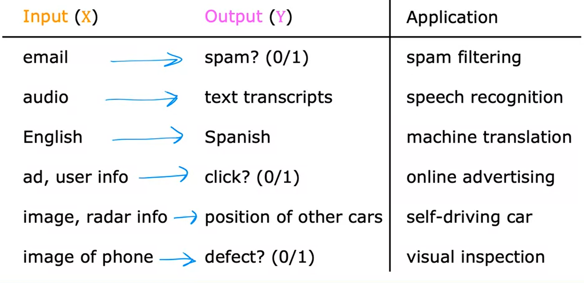
Supervised Learning

Slide 8
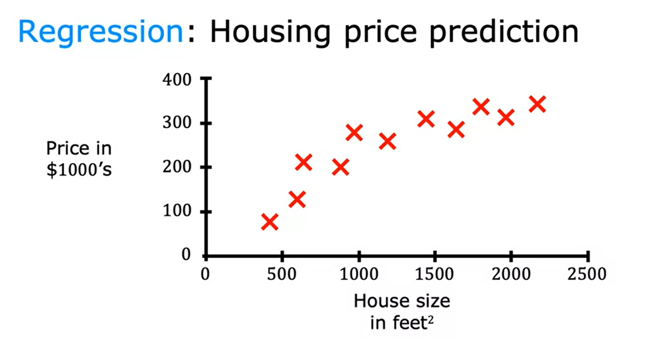
Regression

Slide 9
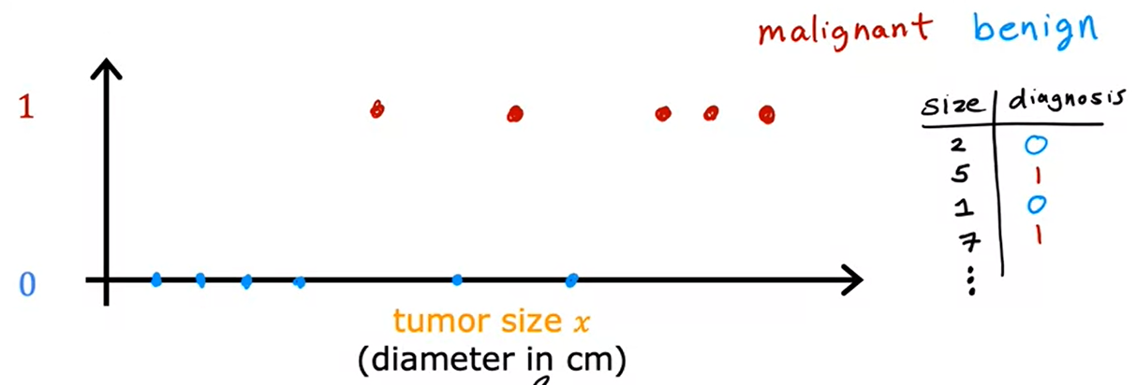
Classification: Breast Cancer Detection

Slide 10
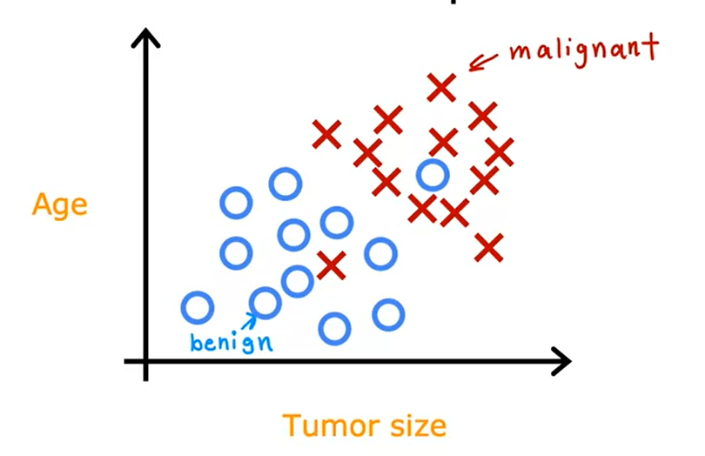
Classification: Breast Cancer Detection with two or more inputs

Slide 11
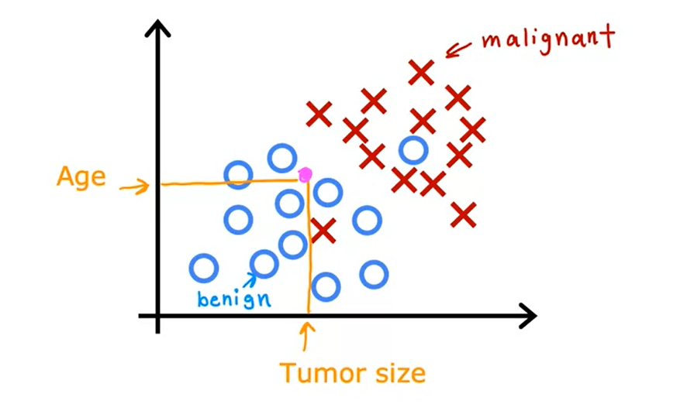
Classification: Breast Cancer Detection with two or more inputs

Slide 12
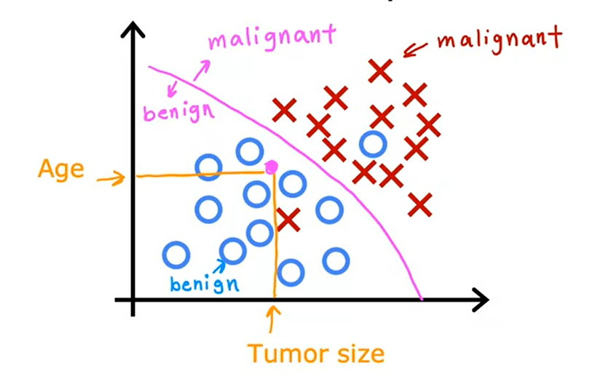
Classification: Breast Cancer Detection with two or more inputs

Slide 13
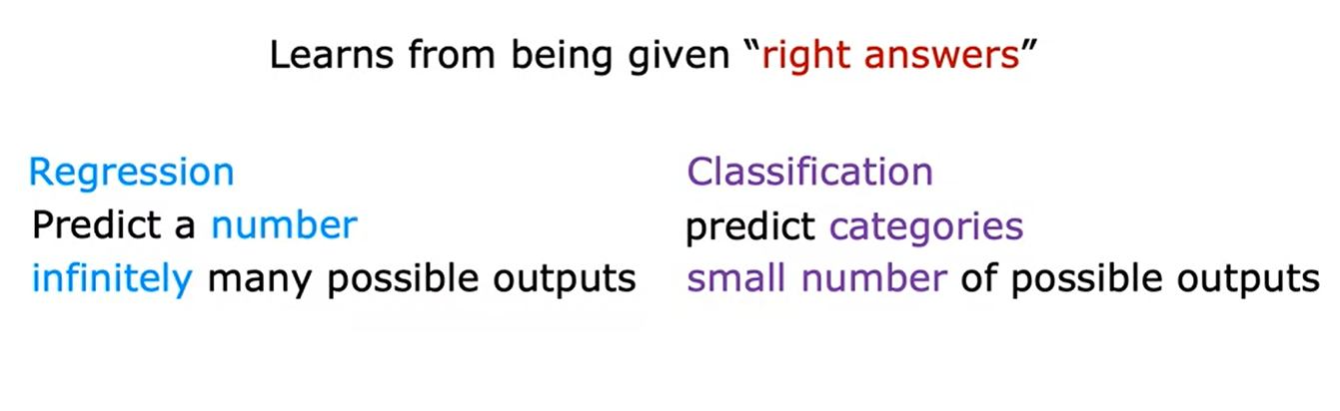
Supervised Learning

Slide 14
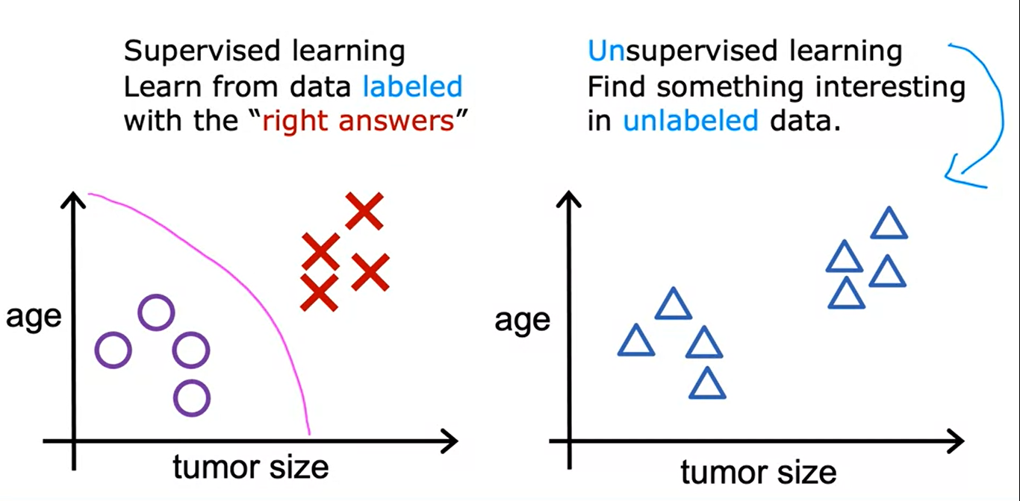
Unsupervised Learning

Slide 15
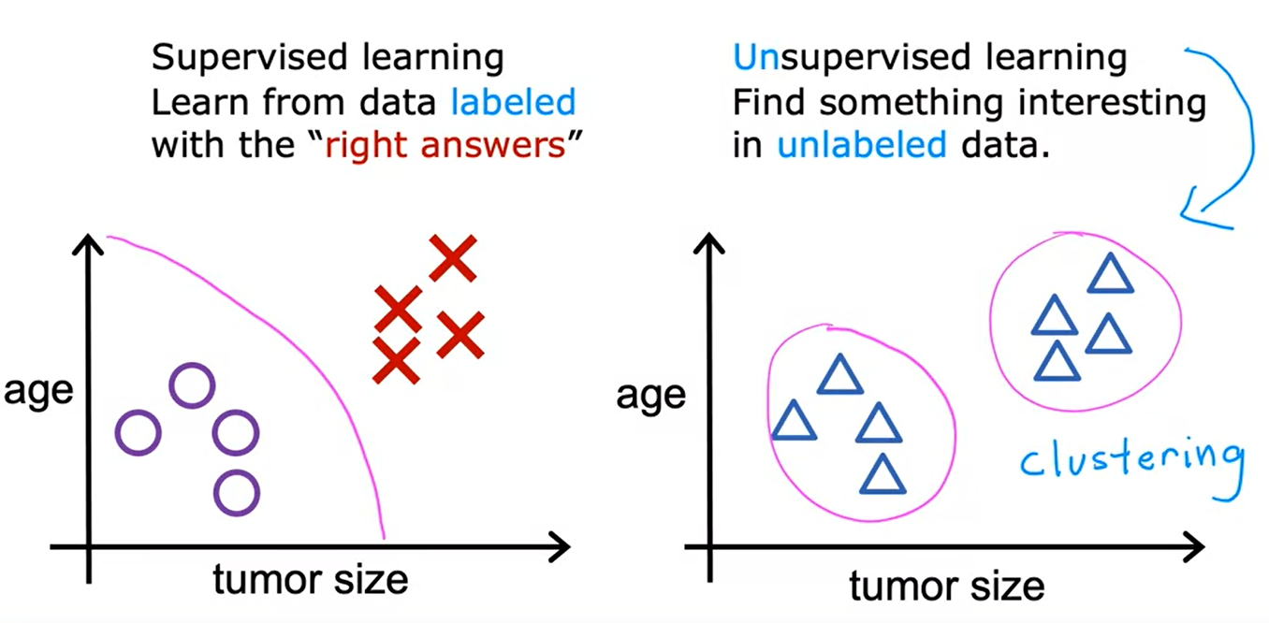
Unsupervised Learning

Slide 16
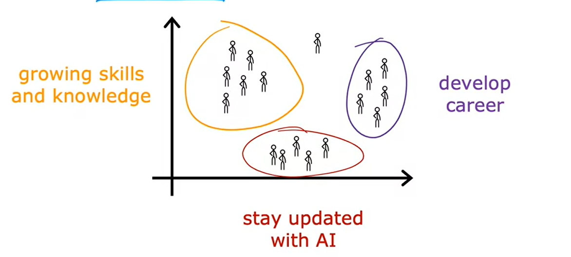
Grouping Students

Slide 17
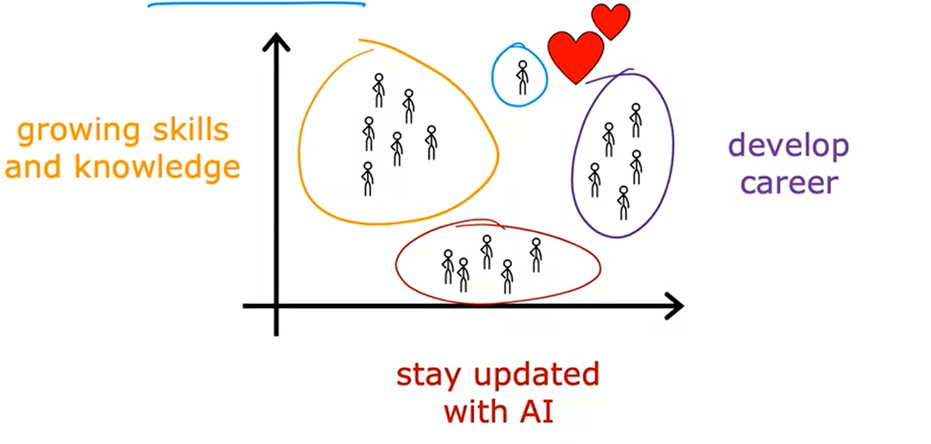
Grouping Students

Slide 18
Unsupervised Learning
Data only comes with inputs x, but not output labels y. Algorithm has to find structure in the data.
Clustering: Group similar data points together.
Anomaly Detection: Find unusual data points.
Dimensionality reduction: Compress data using fewer numbers.

Slide 19
Pattern Recognition
Pattern recognition refers to the process of identifying recurring and meaningful structures or patterns in data.
It is a branch of artificial intelligence and machine learning that involves using algorithms and statistical models to analyze data and identify patterns that can be used to make predictions or classify new data.
In pattern recognition, data is typically represented as a set of features or attributes, and algorithms are used to identify relationships or correlations between these features.
This can be done using a wide range of techniques, including clustering, classification, and regression.

Slide 20
Classification Problems
Classification problems are a type of machine learning problem where the goal is to predict a categorical label or class for a given input data point.
In other words, the task is to assign one of several pre-defined categories or classes to an input based on some features or attributes.
For example, given a dataset of images of animals, a classification model could be trained to recognize and label each image as a dog, cat, bird, or some other animal.
Classification problems can be divided into two types:
Binary classification
Multi-class classification.

Slide 21
Classification Problems
Binary classification involves predicting one of two possible classes, such as spam or not spam
Multi-class classification involves predicting one of three or more possible classes, such as different types of flowers or animals.
Classification models can be trained using a variety of algorithms, such as logistic regression, decision trees, random forests, support vector machines (SVMs), and artificial neural networks.
The performance of a classification model can be evaluated using metrics such as accuracy, precision, recall, and F1 score.

Slide 22

Building a Classifier
Data collection and preparation
Feature selection and engineering
Model selection
Training the model
Hyperparameter tuning
Evaluating the model
Deploying the model

Slide 23
Data collection and preparation
The first step is to collect the data and prepare it for use in the classifier.
This may involve cleaning the data, handling missing values, and transforming the data into a suitable format for machine learning.
For example, if we want to build a classifier to predict the likelihood of a customer buying a particular product, we would collect data on customer demographics, past purchasing behavior, and other relevant information.
We would then clean and preprocess the data by removing missing values, handling outliers, and transforming the data into a suitable format.

Slide 24
Feature selection and engineering
Next, the relevant features or variables that are important for making predictions are selected or engineered.
This may involve removing irrelevant features or creating new features based on the existing data.
For example, in our customer purchase prediction problem, we may select features such as age, income, and purchase history. We may also engineer new features such as the total amount spent by the customer in the past year or the number of products purchased in a single transaction.

Slide 25

Model selection
The appropriate algorithm or model is selected based on the problem and the data.
This may involve experimenting with different models and evaluating their performance using suitable metrics.
For example, we may experiment with different models such as logistic regression, decision trees, and support vector machines to find the best model for our problem.

Slide 26
SN. | Algorithm | Use Case
1 | Linear Regression | Predicting house prices based on features like area, number of rooms, etc. Estimating sales based on advertising spend.
2 | Logistic Regression | Binary classification problems like spam detection. Predicting the likelihood of a customer churn.
3 | Decision Trees | Customer segmentation based on demographics and behavior. Fraud detection in credit card transactions.
4 | Random Forests | Predicting customer satisfaction based on various factors. Medical diagnosis by analyzing patient data
5 | Support Vector Machines (SVM) | Image classification tasks, such as recognizing handwritten digits. Text classification, like sentiment analysis.

Slide 27
SN. | Algorithm | Use Case
1 | K-Nearest Neighbors (KNN) | Recommender systems for suggesting products or movies based on user preferences. Identifying credit card fraud based on similarities to previous fraudulent transactions.
2 | Naive Bayes | Text classification tasks like email spam filtering. Sentiment analysis of social media posts.
3 | Neural Networks (Deep Learning) | Image recognition and object detection in computer vision. Natural language processing tasks like machine translation or language generation.
4 | K-Means Clustering | Customer segmentation for targeted marketing campaigns. Identifying groups of similar documents based on their content.
5 | Principal Component Analysis (PCA) | Dimensionality reduction to visualize high-dimensional data. Image compression to reduce storage requirements.

Slide 28

Training the model
The model is trained on the training data by adjusting the model parameters to minimize the error between the predicted and actual class labels.
Using our chosen model, we would train the model on a labeled dataset where we know the actual purchase behavior of the customers.

Slide 29

Hyperparameter tuning
Hyperparameters are additional parameters that control the behavior of the algorithm, and they are not learned during training.
These parameters are tuned using techniques such as grid search or random search to optimize the performance of the model.
We would then fine-tune the model by adjusting its hyperparameters such as regularization strength, learning rate, or tree depth to optimize its performance.

Slide 30

Evaluating the model
The model is evaluated on a separate validation set using suitable evaluation metrics to assess its performance in making predictions.
We would evaluate the model on a separate validation set by measuring its accuracy, precision, recall, F1 score, or other suitable metrics.

Slide 31
Deploying the model
Once the model has been trained and validated, it can be deployed in production to make predictions on new unseen data.
The deployment may involve creating an application or integrating the model into an existing system.
Once we are satisfied with the performance of our classifier, we can deploy it in production by integrating it into a web application or a larger system where it can be used to make predictions on new unseen data, such as when a customer visits a website or makes a purchase

Slide 32

Classifier Building
Data collection and preparation: Let's say we want to build a spam classifier. We would collect email data that has been labeled as spam or not spam and clean the data by removing stop words, stemming, and tokenizing the text.
Feature selection and engineering: We can select relevant features such as the presence of certain keywords or phrases in the email body, the sender's address, or the time the email was sent. We can engineer new features such as the length of the email, the number of links, or the use of capital letters.
Model selection: We may experiment with different models such as Naive Bayes, Random Forest, or Support Vector Machines to find the best model for our problem.

Slide 33

Classifier Building
Training the model: Using our chosen model, we would train the model on a labeled dataset where we know whether each email is spam or not.
Hyperparameter tuning: We would fine-tune the model by adjusting its hyperparameters such as the number of trees, the regularization strength, or the kernel type to optimize its performance.
Evaluating the model: We would evaluate the model on a separate validation set by measuring its accuracy, precision, recall, F1 score, or other suitable metrics.
Deploying the model: Once we are satisfied with the performance of our spam classifier, we can deploy it in production by integrating it into an email system where it can be used to classify incoming emails as spam or not spam.

Slide 34
Evaluating Classifier
Evaluating a classifier is an important step in machine learning to determine the performance of the model in making predictions.
The evaluation process involves measuring the accuracy of the classifier in correctly identifying the correct class labels for a given set of input data.
There are several evaluation metrics that can be used to assess the performance of a classifier, including:
Accuracy : measures the proportion of correctly classified instances to the total number of instances.

Slide 35
Evaluating Classifier
Precision: measures the proportion of true positive predictions to the total number of positive predictions.
Recall: measures the proportion of true positive predictions to the total number of positive instances.
F1 Score: is the harmonic mean of precision and recall, which provides a balance between precision and recall.
Confusion Matrix: is a table that summarizes the number of correct and incorrect predictions made by a classifier.
Receiver Operating Characteristic (ROC) Curve: is a plot of the true positive rate against the false positive rate, which helps to assess the trade-off between sensitivity and specificity.

Slide 36
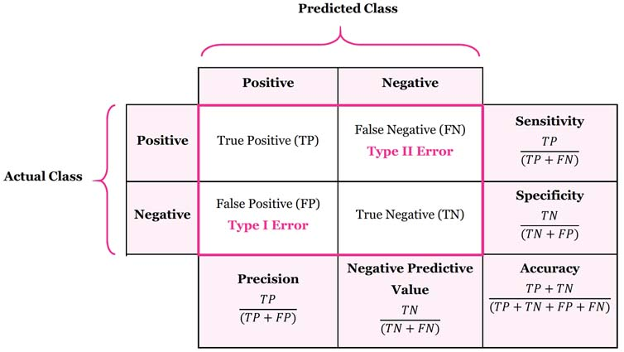

Slide 37
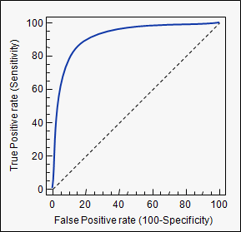
ROC Curve

Slide 38

Evaluating Classifier
The choice of evaluation metric depends on the specific problem and the goal of the classifier.
For example, in a medical diagnosis application, the recall may be more important than precision to avoid missing any potentially harmful conditions.
On the other hand, in a spam classification application, precision may be more important to avoid incorrectly labeling legitimate emails as spam.
It is important to evaluate a classifier on a separate validation set that is not used during training to avoid overfitting, which occurs when the model performs well on the training data but poorly on new unseen data.
Cross-validation techniques such as k-fold cross-validation can be used to estimate the performance of the classifier on new data.

Slide 39
Suppose we have a dataset of 100 patients, out of which 20 have cancer (true positive cases) and 80 do not have cancer (true negative cases). We build a medical diagnosis model that predicts whether a patient has cancer or not.
In this case, let's assume the model achieves the following performance:
True Positives (TP): 18 (correctly predicted cancer cases), False Negatives (FN): 2 (missed cancer cases), True Negatives (TN): 75 (correctly predicted non-cancer cases), False Positives (FP): 5 (incorrectly predicted cancer cases)
The recall can be calculated as:
Recall = TP / (TP + FN) = 18 / (18 + 2) = 0.9 or 90%
The precision can be calculated as:
Precision = TP / (TP + FP) = 18 / (18 + 5) ≈ 0.783 or 78.3%
In this case, the recall of 90% indicates that the model correctly identifies 90% of the cancer cases, while the precision of 78.3% indicates that out of all the predicted cancer cases, only 78.3% are true cancer cases.

Slide 40
Suppose we have a dataset of 1000 emails, out of which 200 are legitimate (not spam) and 800 are spam. We develop a spam classification model to identify spam emails accurately.
Let's assume the model achieves the following performance:
True Positives (TP): 180 (correctly predicted spam cases), False Negatives (FN): 20 (missed spam cases), True Negatives (TN): 760 (correctly predicted legitimate cases), False Positives (FP): 40 (incorrectly predicted legitimate cases as spam)
The recall can be calculated as:
Recall = TP / (TP + FN) = 180 / (180 + 20) = 0.9 or 90%
The precision can be calculated as:
Precision = TP / (TP + FP) = 180 / (180 + 40) ≈ 0.818 or 81.8%
In this case, the recall of 90% indicates that the model correctly identifies 90% of the spam emails, while the precision of 81.8% indicates that out of all the predicted spam emails, only 81.8% are true spam emails.

Slide 41
Nearest Neighbor Methods
Nearest Neighbor methods are a type of machine learning algorithm that can be used for classification or regression tasks.
The basic idea behind nearest neighbor methods is to predict the class or value of a new data point based on the classes or values of its nearest neighbors in the training data.
There are two main types of nearest neighbor methods:
k-Nearest Neighbors (k-NN): In k-NN, the value or class of a new data point is predicted based on the majority vote of its k nearest neighbors in the training data. The value of k is a hyperparameter that needs to be specified prior to training the model.
Radius-Based Nearest Neighbors (RNN): In RNN, the value or class of a new data point is predicted based on the average or median value or class of its neighbors within a certain radius. The radius is also a hyperparameter that needs to be specified prior to training the model.

Slide 42
k-Nearest Neighbor
K-Nearest Neighbors (K-NN) is a simple machine learning algorithm that is widely used for both regression and classification tasks.
The main idea behind K-NN is to classify new data points based on their similarity to the training data.
K-NN assumes that data points that are close to each other in the feature space are more likely to belong to the same class or have similar values.
When a new data point is presented to the algorithm, K-NN finds the K closest points in the training data and assigns the class or value that is most common among those K neighbors.
K-NN is a non-parametric algorithm, which means that it does not make any assumptions about the underlying data distribution.

Slide 43
k-Nearest Neighbor
It is also a lazy learner algorithm because it does not learn a model during training, but instead, stores the training data and uses it for classification at test time.
One of the main advantages of K-NN is its simplicity and interpretability.
It can be easily understood and implemented without requiring complex mathematical computations.
Additionally, K-NN can handle both continuous and categorical data and can work well with small datasets.

Slide 44
k-Nearest Neighbor
One of the main challenges is choosing an appropriate value for K, which can significantly impact the performance of the algorithm.
K-NN can also be sensitive to irrelevant features or outliers, which can lead to poor performance.
Furthermore, as the size of the dataset grows, the computational cost of finding the K-nearest neighbors can become prohibitive.
Overall, K-NN is a powerful and flexible algorithm that can be used for a wide range of classification and regression problems.

Slide 45
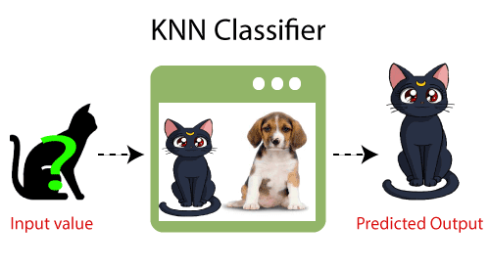
Example k-Nearest Neighbor
Suppose, we have an image of a creature that looks similar to cat and dog, but we want to know either it is a cat or dog.
So for this identification, we can use the KNN algorithm, as it works on a similarity measure.
Our KNN model will find the similar features of the new data set to the cats and dogs images and based on the most similar features it will put it in either cat or dog category.

Slide 46

How does K-NN work?
Choose a value for k. The value of k is a hyperparameter that controls the behavior of the algorithm. A small value of k will make the algorithm more sensitive to noise, while a large value of k will make the algorithm more robust to noise.
Calculate the distance between the new instance and all instances in the training set. The distance can be calculated using any distance metric, such as the Euclidean distance, the Manhattan distance, or the Hamming distance.
Find the k instances in the training set that are closest to the new instance. The k nearest neighbors can be found using any algorithm for finding the closest neighbors, such as the brute-force algorithm, the kd-tree algorithm, or the ball tree algorithm.
Predict the label of the new instance. The label of the new instance can be predicted by majority vote or by averaging the labels of the k nearest neighbors.

Slide 47
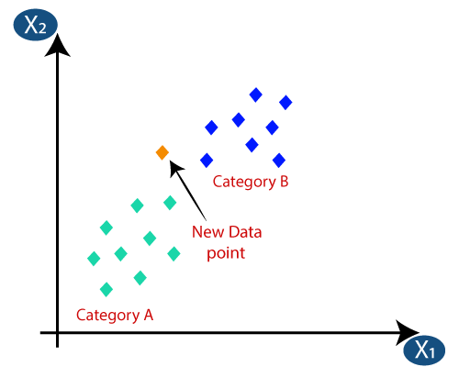
Suppose we have a new data point and we need to put it in the required category. Consider the below image:

Slide 48
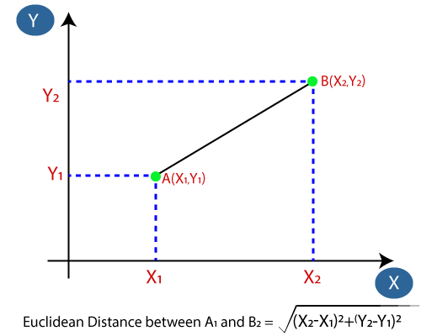
Firstly, we will choose the number of neighbors, so we will choose the k=5.
Next, we will calculate the Euclidean distance between the data points.
The Euclidean distance is the distance between two points, which we have already studied in geometry. It can be calculated as:

Slide 49
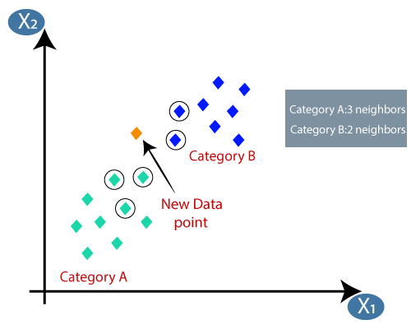
By calculating the Euclidean distance we got the nearest neighbors, as three nearest neighbors in category A and two nearest neighbors in category B.

Slide 50
How to select the value of K in the K-NN Algorithm?
There is no particular way to determine the best value for "K", so we need to try some values to find the best out of them.
The most preferred value for K is 5.
A very low value for K such as K=1 or K=2, can be noisy and lead to the effects of outliers in the model.
Large values for K are good, but it may find some difficulties.

Slide 51
Advantages of KNN Algorithm
It is simple to implement.
It is robust to the noisy training data
It can be more effective if the training data is large.

Slide 52
Disadvantages of KNN Algorithm
Always needs to determine the value of K which may be complex some time.
The computation cost is high because of calculating the distance between the data points for all the training samples.

Slide 53
Hands on Practice
Data point Feature 1 Feature 2 Feature 3 Label
---------------------------------------------------------------------------
Data point 1 2.0 3.5 1.5 A
Data point 2 4.5 2.0 3.0 B
Data point 3 3.0 4.0 2.5 B
Data point 4 2.5 2.0 2.0 A
Data point 5 3.5 2.5 1.0 A
Let's say we want to classify a new data point with the following feature values: Feature 1 = 3.8, Feature 2 = 3.2, and Feature 3 = 2.8.

Slide 54
Compute Euclidean distances
Distance between new point and Data point 1: sqrt((2.0-3.8)^2 + (3.5-3.2)^2 + (1.5-2.8)^2) = 2.24
Distance between new point and Data point 2: sqrt((4.5-3.8)^2 + (2.0-3.2)^2 + (3.0-2.8)^2) = 1.4
Distance between new point and Data point 3: sqrt((3.0-3.8)^2 + (4.0-3.2)^2 + (2.5-2.8)^2) = 1.17
Distance between new point and Data point 4: sqrt((2.5-3.8)^2 + (2.0-3.2)^2 + (2.0-2.8)^2) = 1.89
Distance between new point and Data point 5: sqrt((3.5-3.8)^2 + (2.5-3.2)^2 + (1.0-2.8)^2) = 2.75

Slide 55
Select the value of k, the number of nearest neighbors to consider. Let's say we choose k = 3.
Find the k nearest neighbors: The three nearest neighbors based on Euclidean distance are Data point 3, Data point 2, and Data point 4.
Classify the new data point: Since two of the three nearest neighbors are labeled as B, and only one is labeled as A, we classify the new data point as B.

Slide 56
Training
The training data is the portion of the data used to train the model, i.e., to learn the relationships between the input features and the output values.
The model is typically trained by minimizing a loss function that measures the difference between the predicted output and the actual output.

Slide 57
Validation
The validation data is a separate portion of the data used to tune the hyperparameters of the model, such as the learning rate, regularization strength, or the number of hidden units.
The purpose of the validation data is to prevent overfitting, which is when the model becomes too complex and fits the training data too closely, resulting in poor performance on new data.

Slide 58
Testing
The testing data is a completely separate portion of the data used to evaluate the final performance of the model.
The purpose of the testing data is to estimate the generalization performance of the model, i.e., how well the model will perform on new, unseen data.
It is important to keep the validation and testing data separate from the training data to avoid overfitting and to obtain an unbiased estimate of the model's performance.
The recommended split ratio is usually 60-20-20, meaning that 60% of the data is used for training, 20% for validation, and 20% for testing.

Slide 59
Underfitting
Underfitting occurs when a machine learning model is too simple to capture the underlying patterns in the data.
In other words, the model is not able to fit the training data well enough, resulting in poor performance on both the training and test data.
Underfitting happens when the model is too simple or has too few parameters relative to the complexity of the data.
This means that the model is too biased towards a particular subset of features and is not able to generalize well to new, unseen data.
To detect underfitting, one can monitor the performance of the model on both the training and test data.
If the performance on both datasets is poor, then it is likely that the model is underfitting.

Slide 60
Overfitting
Overfitting is a common problem in machine learning, which occurs when a model is too complex and fits the training data too closely.
In other words, the model becomes too specialized to the training data and does not generalize well to new, unseen data.
Overfitting happens when a model is too complex or has too many parameters relative to the amount of training data.
The model starts to memorize the training data instead of learning the underlying patterns, resulting in poor performance on new data.
One way to detect overfitting is to monitor the performance of the model on both the training and validation data during training.
If the performance on the training data keeps improving while the performance on the validation data starts to degrade, then it is likely that the model is overfitting.

Slide 61


Slide 62
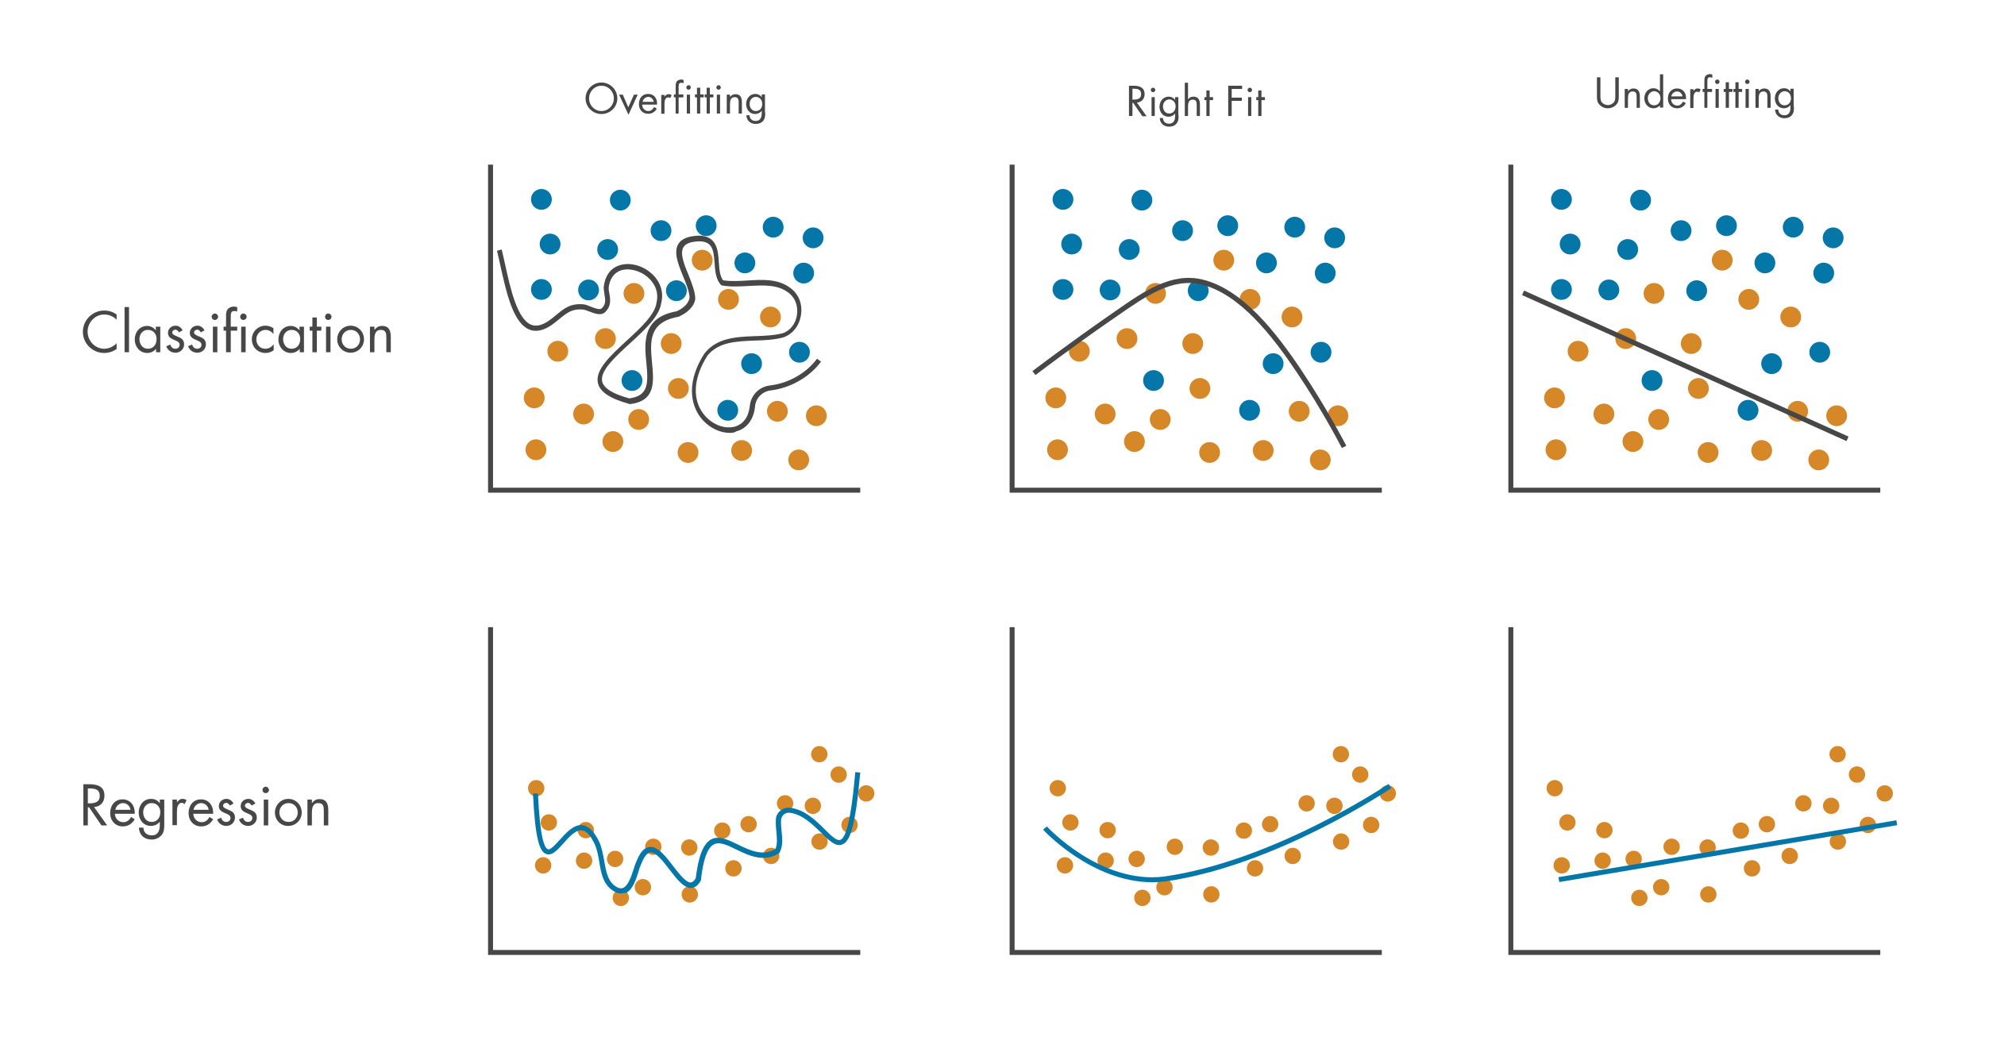

Slide 63
Computational Complexity
Computational Complexity determines how much time and resources are required to train and evaluate a model.
The computational complexity of a machine learning model is determined by several factors, such as the number of features, the size of the training data, and the complexity of the model itself.
To address computational complexity, there are several techniques that can be used:
Dimensionality reduction
Sampling
Model selection
Hardware acceleration

Slide 64

Thank you

